Slide 1
Data Analysis, Team Work, and the Turnaround of a $500 Million Dollar Oil Asset
Alvin D. Anderson

Slide 2
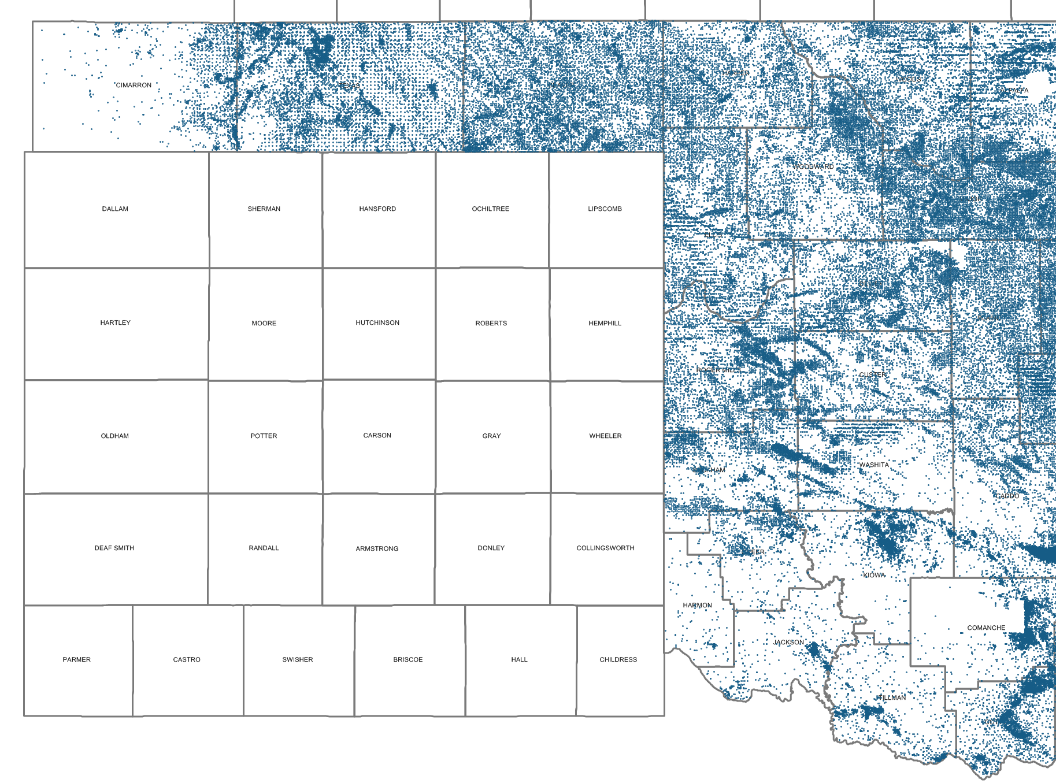
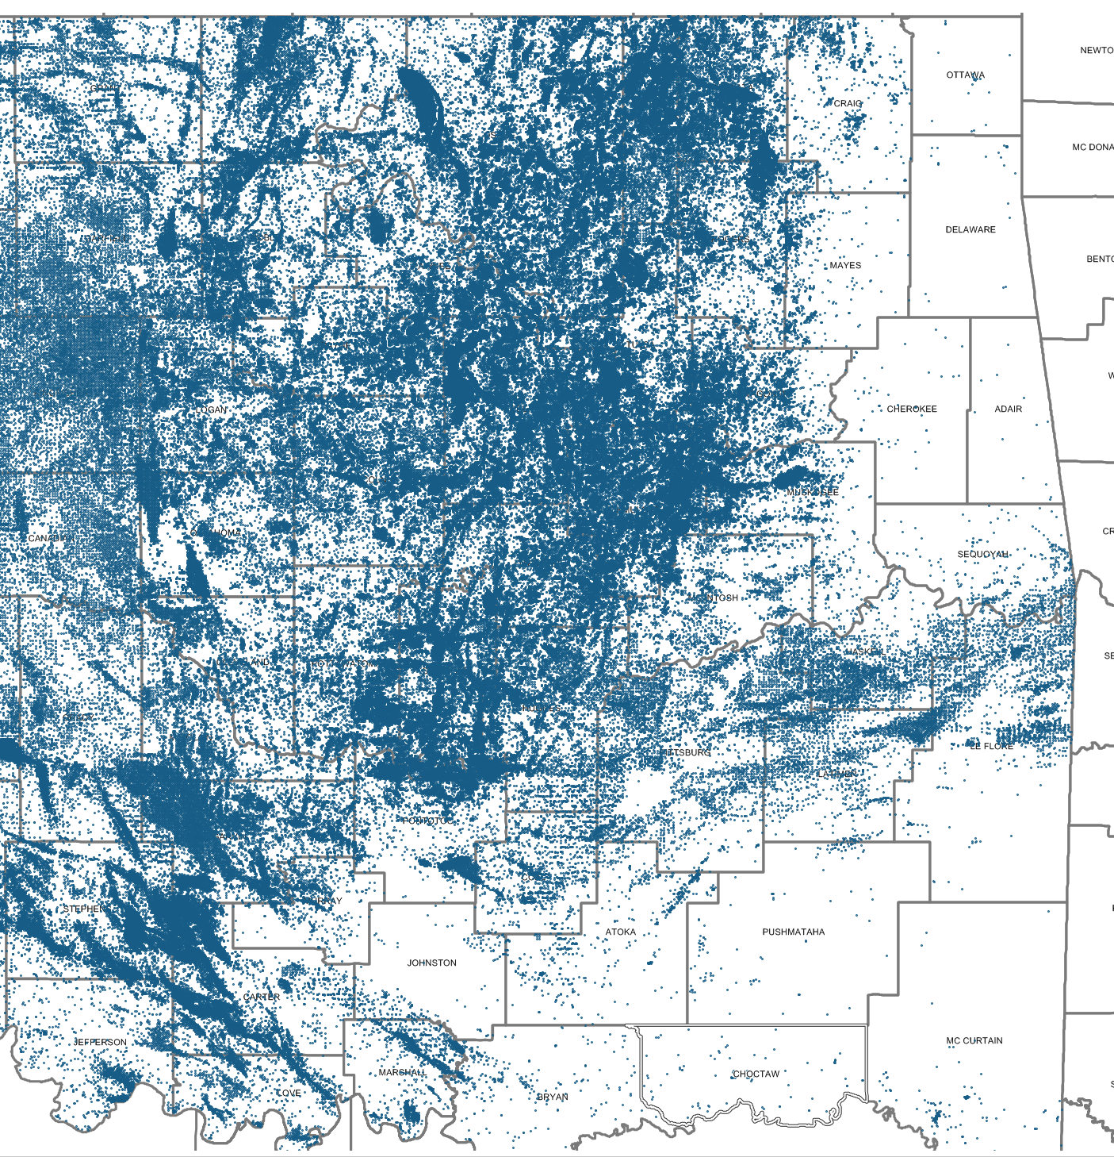
Oklahoma Oil and Natural gas Wells
>540,000 oil and gas wells have been drilled in Oklahoma

Slide 3
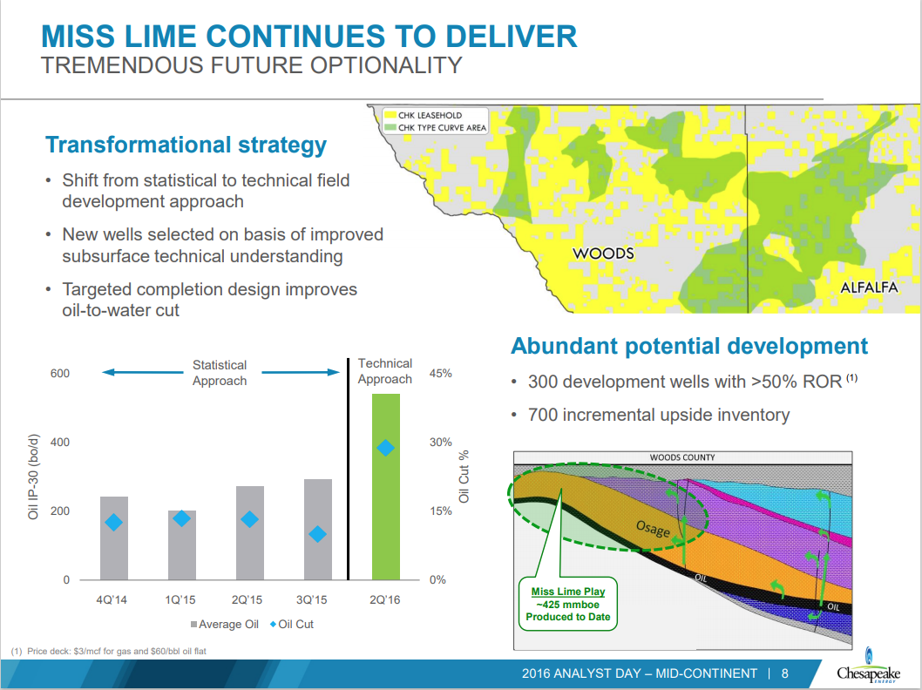
Notes:
The story I’m going to tell today is the story of a turnaround that I helped lead. This is a slide built by others for an investor presentation in 2016. It shows that average oil production from new wells more than doubled from 2015 to 2016. As the slide points out, this had a transformational impact on the economics of the play. This change did not happen by chance, it was the result of concerted, analytical, multidisciplinary approach. That approach led to a dramatically improved understanding the subsurface system where the oil was trapped.
Statistical approach - Meaning that on average the good wells would be good enough to pay for the bad wells

Slide 4
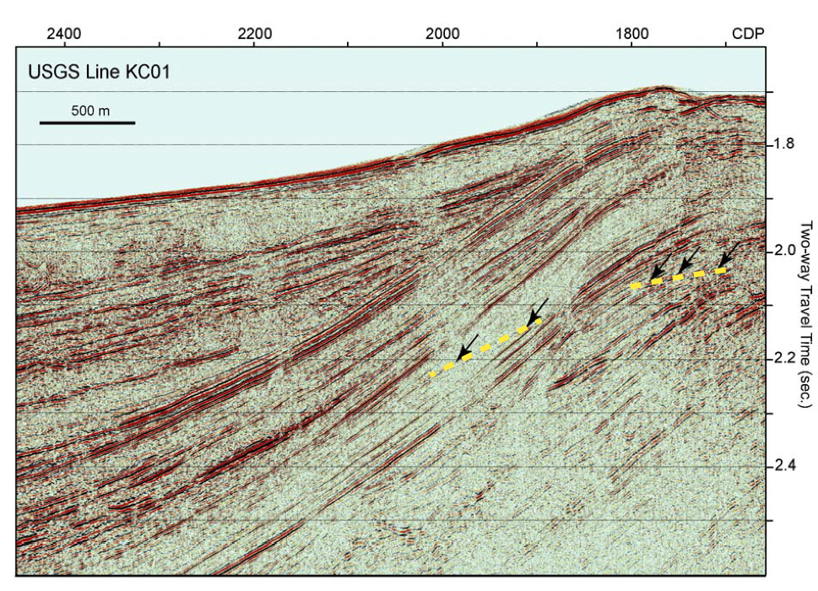
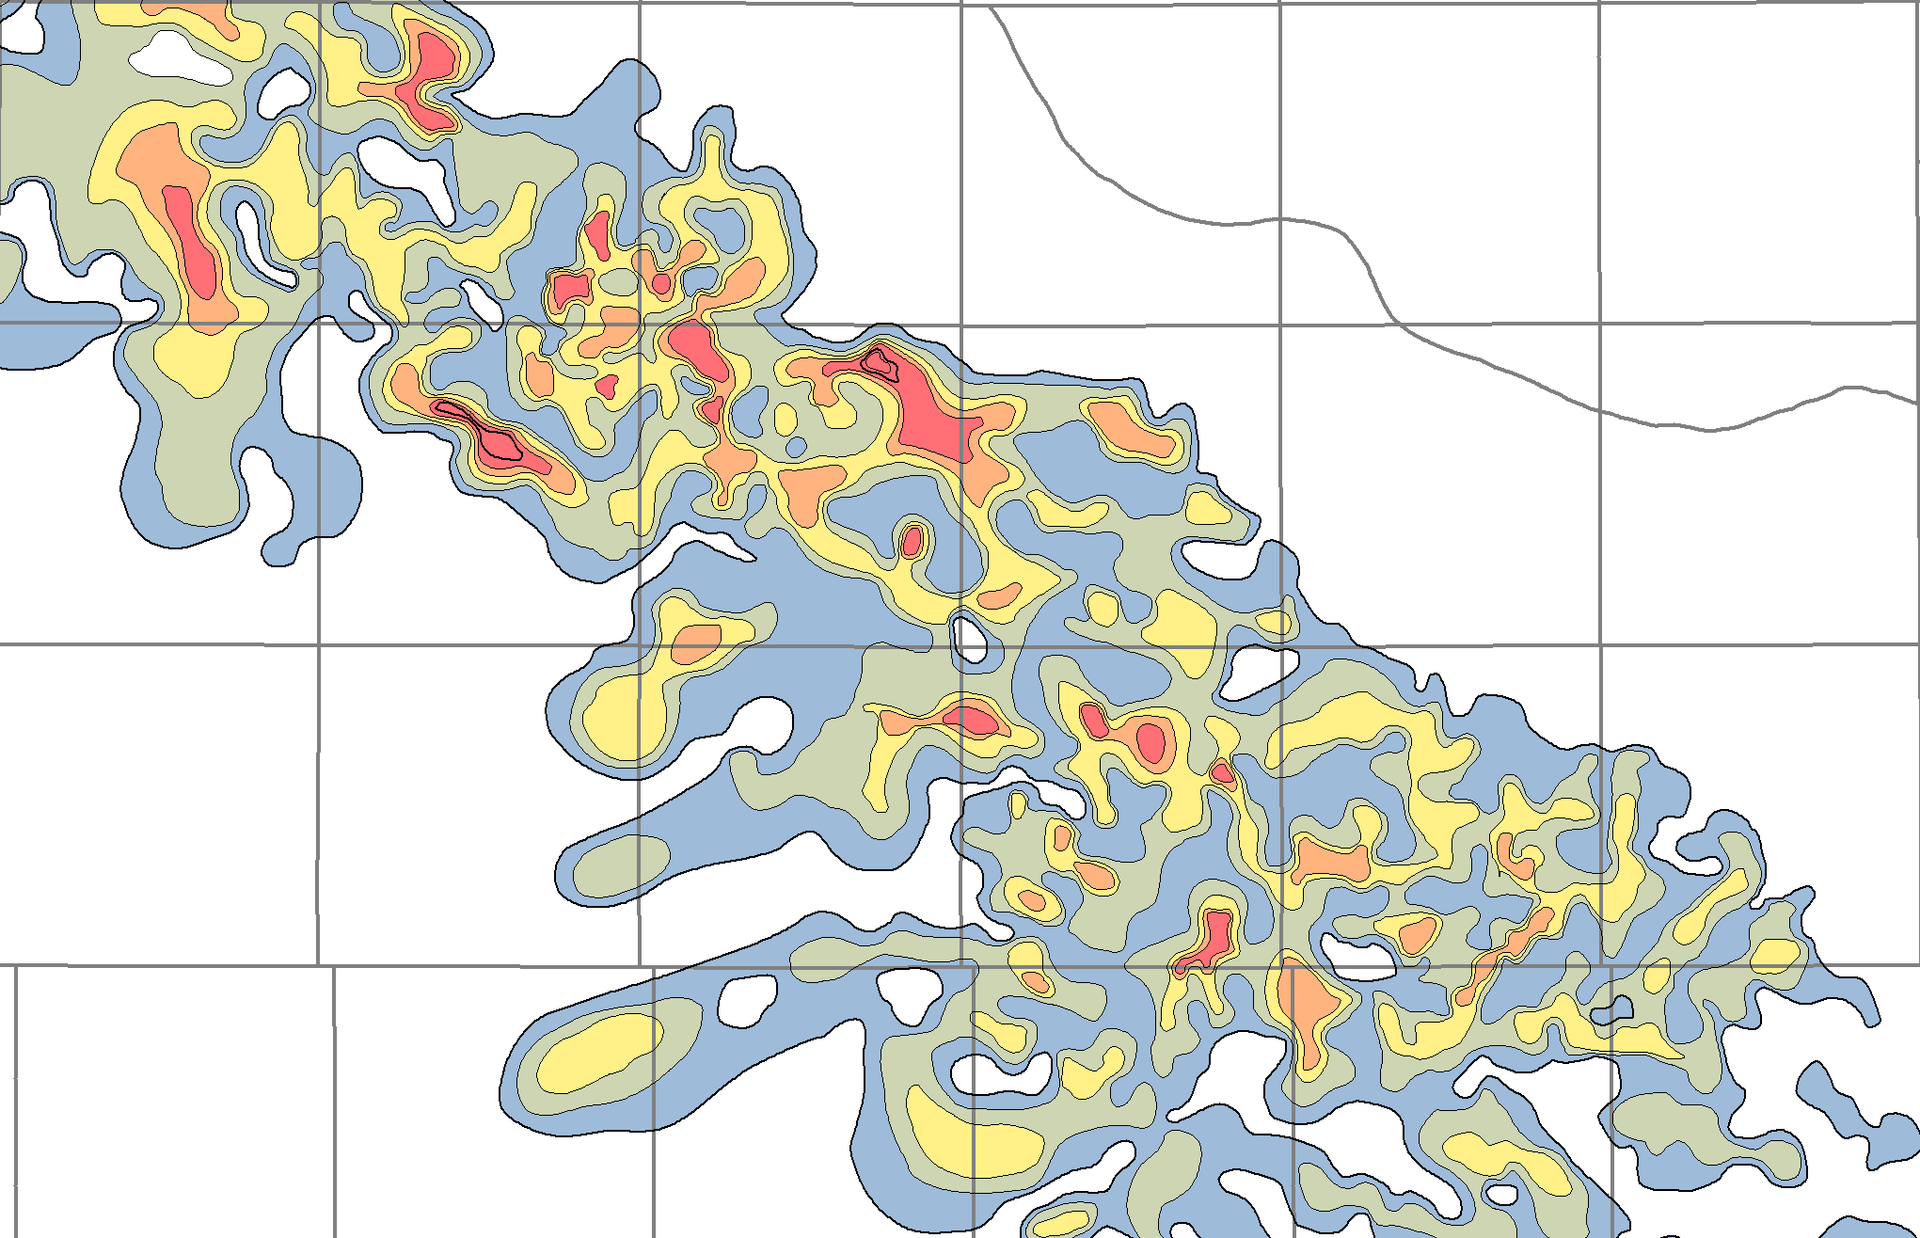
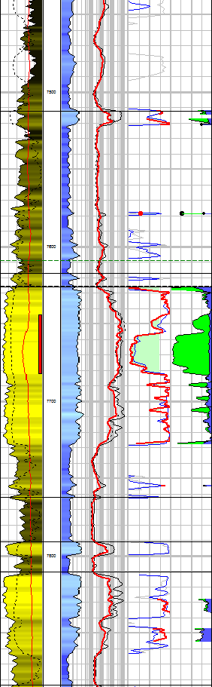
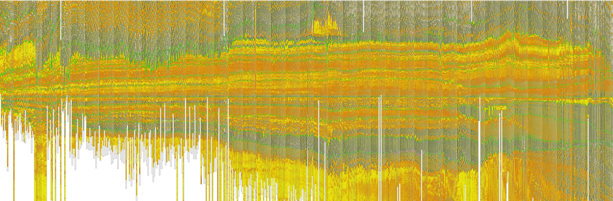
The Data-Driven Search for Oil and gas

Slide 5
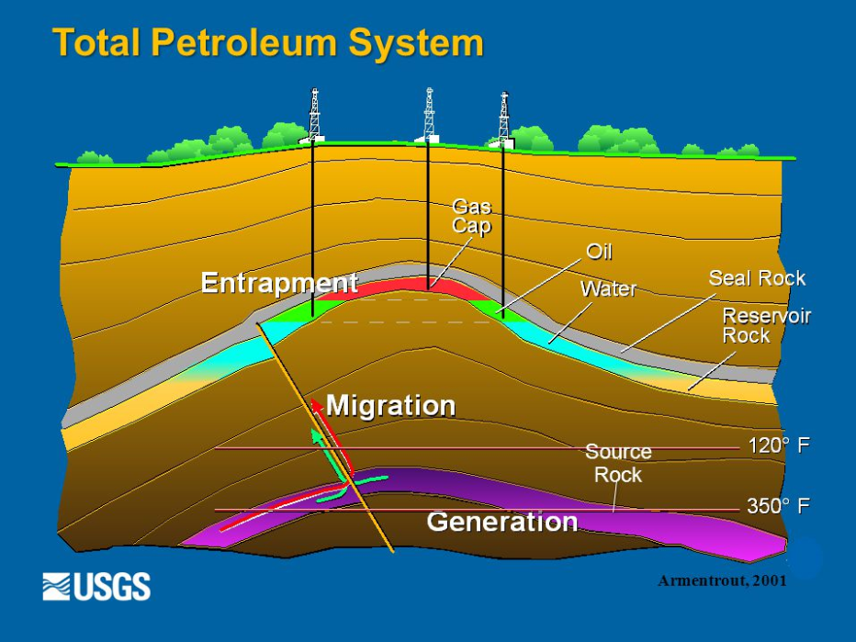
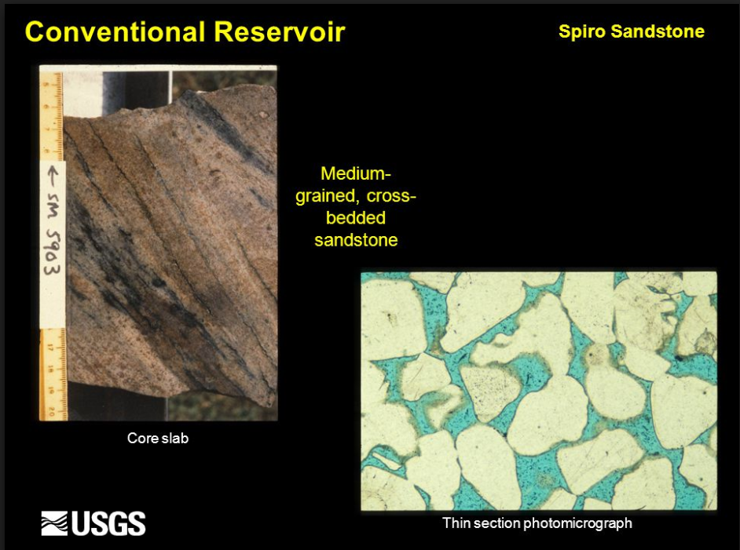
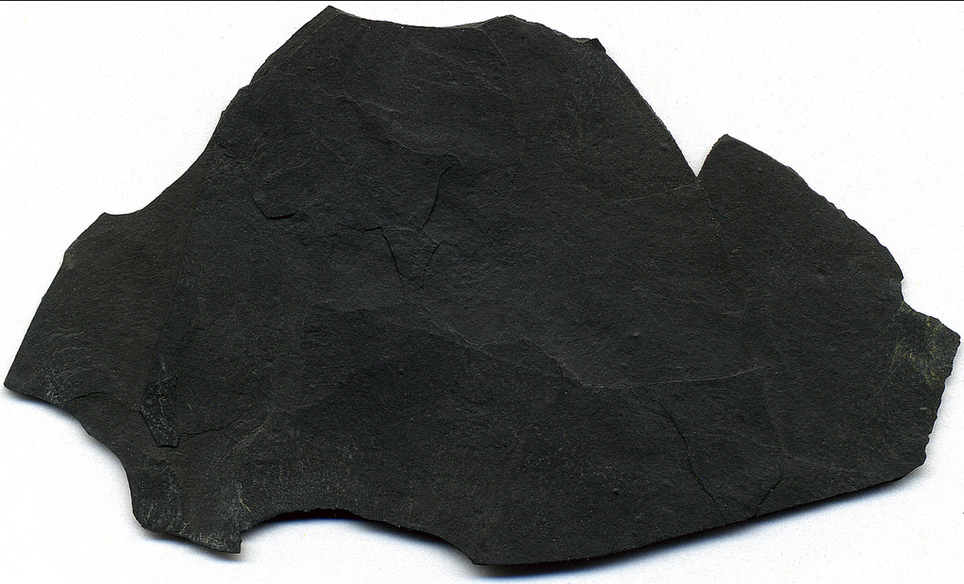
Petroleum System The key to Discovering Oil and Gas
To find oil underground the following 5 components must exist:
Source Rock
Migration
Reservoir (porous rocks)
Trap
Seal
Porous Sandstone
Black Organic Shales
+ HEAT = OIL

Slide 6
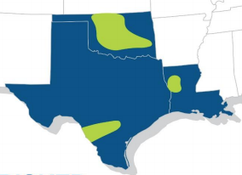
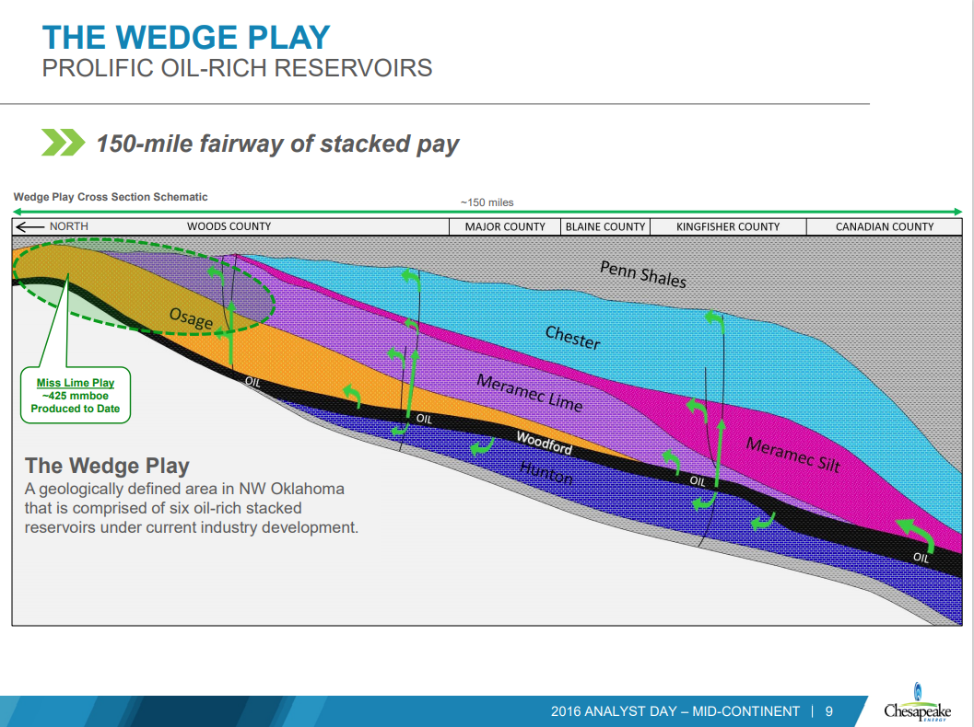
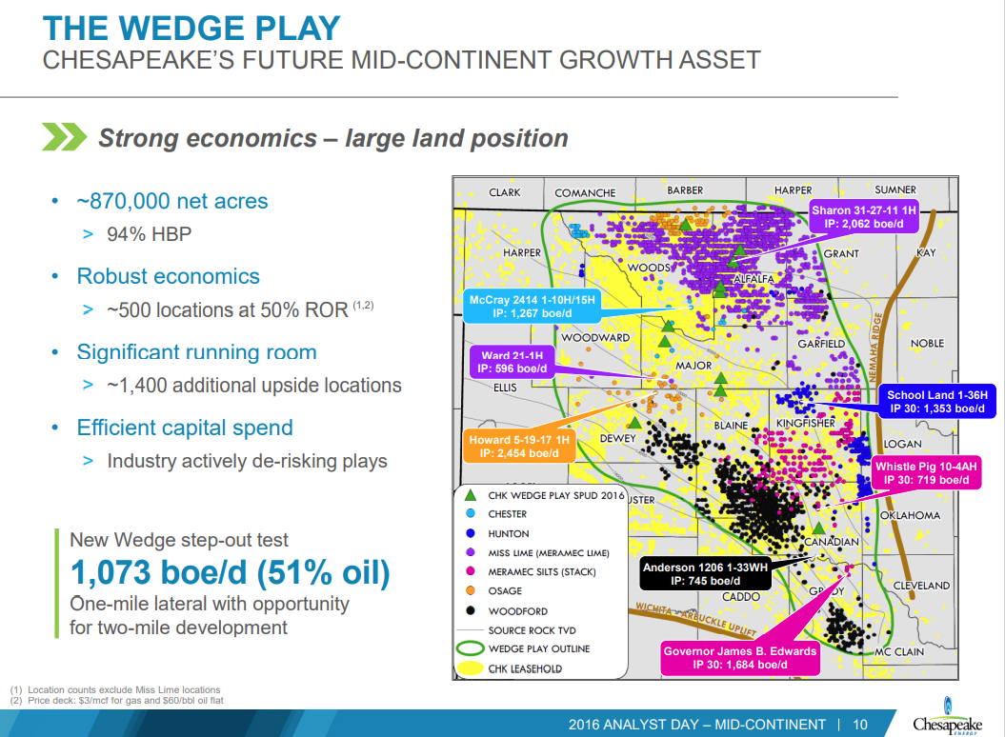
Miss Lime Play
Chesapeake Energy had spent 100’s of millions of dollars drilling wells and developing infrastructure in an oil-producing rock layer called the Miss Lime.

Slide 7
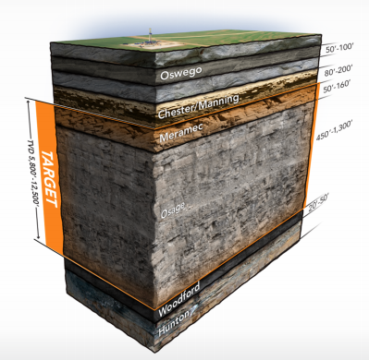
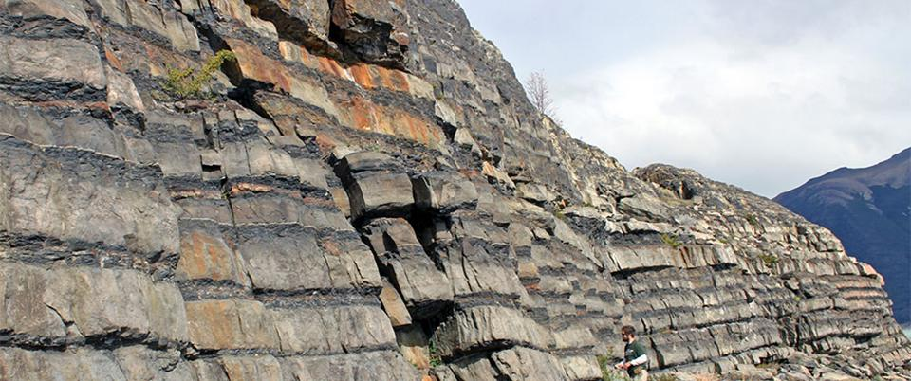
Miss Lime
The Miss Lime was notoriously unpredictable and complex.
After years of drilling wells in the oil-producing rock layer, Chesapeake was ready to pull the plug. Largely due to poor ROI and unpredictable results.
Clearly, the status quo wasn’t working!
Notes:
Tell the story of meeting with the outgoing team.

Slide 8
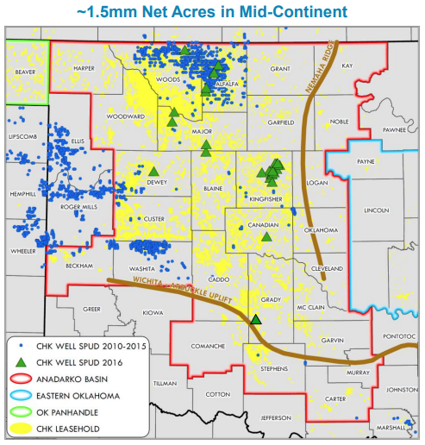
Project Objective
Was brought in to co-lead a small technical team
GOALS:
Improve technical understanding
Improve predictability and certainty of delivery
Identify best drill locations in a 2000 square mile area.
Task seemed daunting
Notes:
I knew that only way we were going to solve this problem, was to use data to analyze and better understand the system that the oil was trapped in.

Slide 9

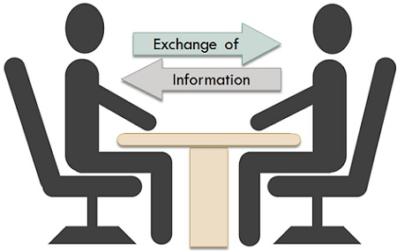
Communication and Team Buy in
Started with communication.
Met regularly with the team members and management early on to establish trust and buy in.
Communicated our plan to gather, analyze, and use data to improve understanding of the petroleum system.
Met regularly with team members to set objectives, develop plans, and solicit feedback.
Communicated technical details of project clearly and simply.

Slide 10
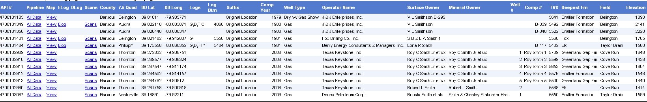




Data Wrangling
Met with geoscientists, engineers, IT to understand and identify data sources
Located, cleaned, and connected to a wide range of disparate data
Corporate data, 3rd Party Vendor Data, Public Data, Team Spreadsheets
Notes:
I knew that only way we were going to solve this problem, was to use data to analyze and better understand the system that the oil was trapped in. So, the first thing I did to help solve this problem was find, clean, and integrate a wide range of disparate data. Next, I plotted and analyzed the data. One particular plot revealed a shocking discovery. The best producing wells in the play lined up perfectly with the know faults in the area. We had several aha moments along the way. Third, I build a conceptual 3D model of the petroleum system incorporating observations and known principles. Finally, once we had a better understanding of the system we were dealing with, I helped develop a multivariate model and predictive oil production map.

Slide 11
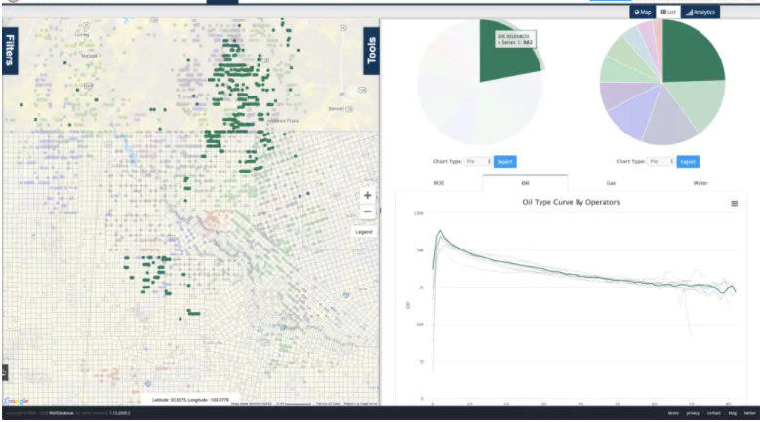
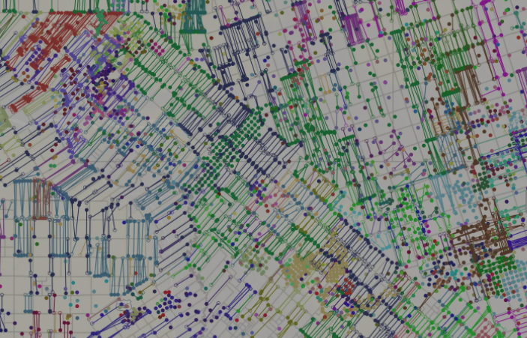
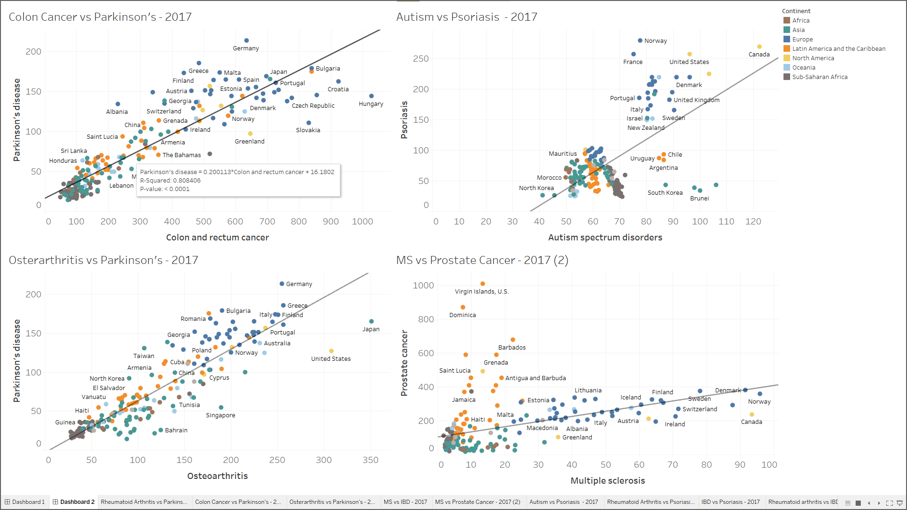
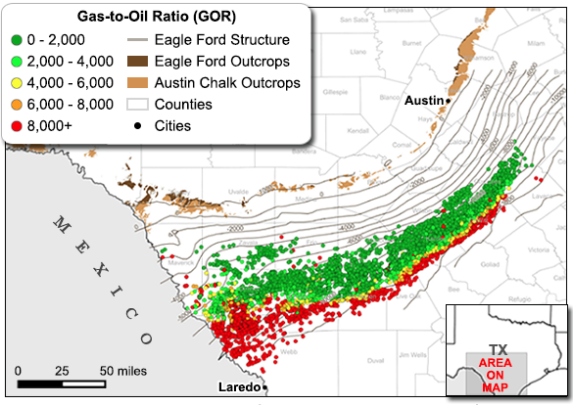
BI Visualization an Analytics tool
Built a visualization and analytics tool that linked to various key data sources

Slide 12
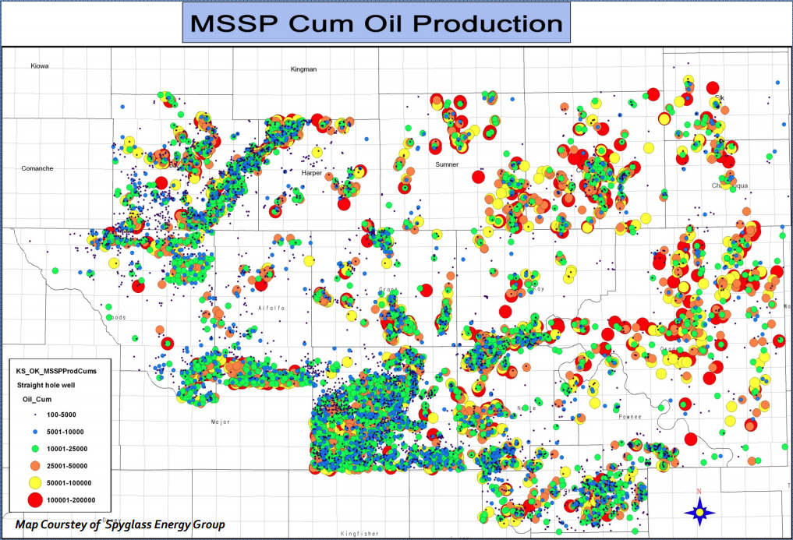
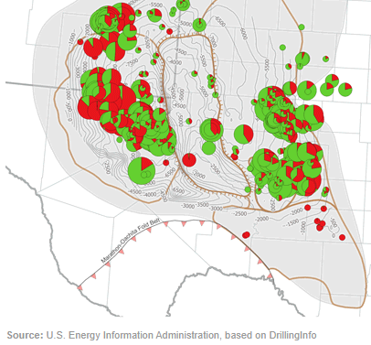
Data Exploration
Explored, plotted, analyzed, and mapped the data
Production Data
Oil, Gas, Water
Well Data
X, Y, Depth, Azimuth
Geologic Data
Formation, Distance to nearest fault, Relative high or low, Porosity, Oil volume, Water sat, etc.
Reservoir fluid Data
Pressure, Temperature, GOR, etc.
Proximity to offset wells
Production within 500, 1000, 2000 feet
Frac Data
total proppant, total fluid, # of stages

Slide 13
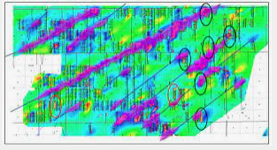
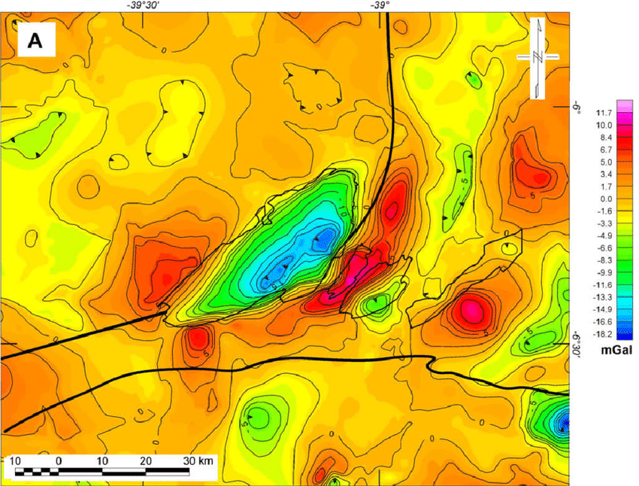
New Insights and Discovery
One particular plot revealed a shocking discovery.
The best producing wells in the play lined up perfectly with the known faults in the area.
We also discovered that the best wells were located on subtle structural highs (reds), along with several other discoveries.

Slide 14
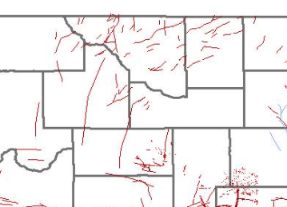
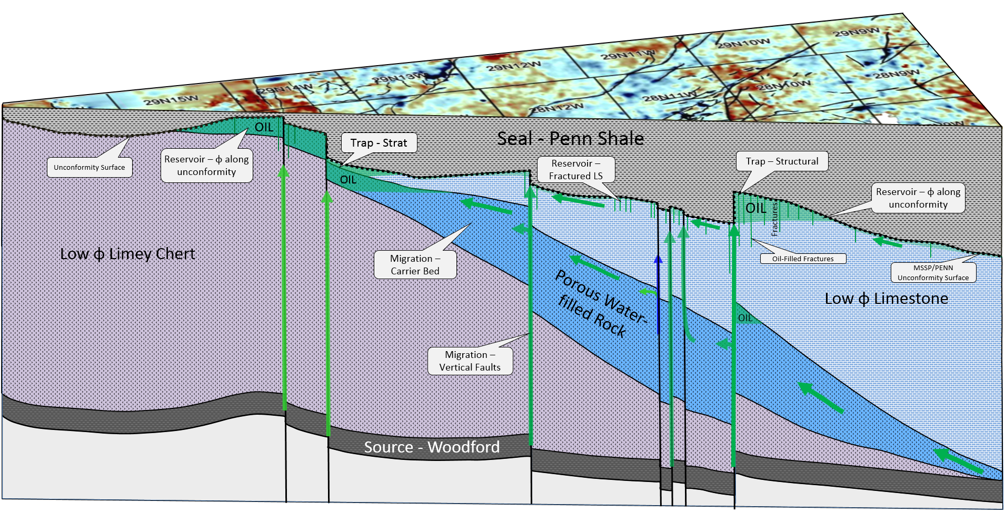
Conceptual Model Miss Lime Petroleum System
Built a conceptual model incorporating observations and known principles.
Notes:
Once we began to see which variables were have a significant impact on production. I was able to use those observations to create a conceptual model to help us and others visualize the subsurface system
This figure that I created in 2016 gives a basic view of the petroleum system for the Miss Lime. Oil is generated in a black shale 100 feet below the Miss Lime and migrates along faults to the Miss Lime Reservoir where some of it is trapped

Slide 15
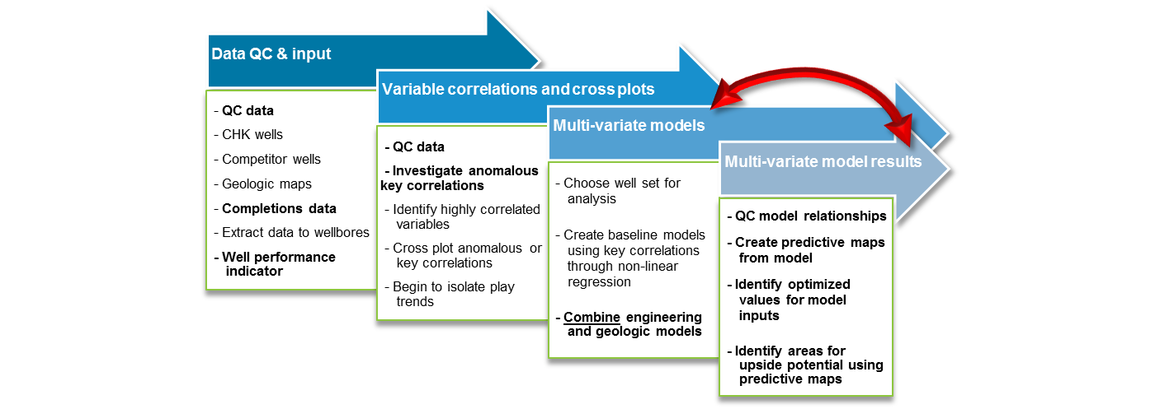

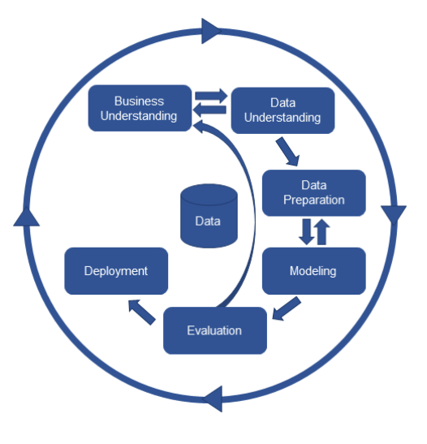
Multivariate Statistics and Modeling
Goal: Develop a model and map to predict 12 month oil production.
What are the drivers of 12 month oil production?
Data exploration, visualizations, and conceptual model all suggested that 12 month oil production was driven by the interplay of various geologic and reservoir parameters.
No bi-variate cross-plot of variables were capable of adequately predicting 12 month oil production.
To properly model production; we considered various geologic and engineering attributes
A vs. B vs. C vs. D vs. E
Notes:
The next step was to use statistical and analytical techniques to develop a predictive model and map. Our goal was to predict the first year of oil production, since that was the big economic driver of each well.

Slide 16
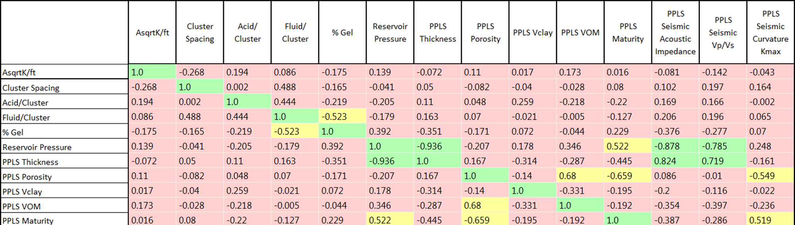
Multivariate Model
Used linear regression and correlation tables to identify variables that correlate with 12 month oil production.
Removed collinear variables to avoid redundancy and overtraining the model
Selected variables for model inputs to:
Maximize stability, usability, predictive capability, and buy-in
Initial Model Inputs
~700 wells
10 geologic attributes
6 engineering variables
5 seismic attributes
Notes:
No bivariate correlations adequately predict deliverability
R2 coefficient of determination (i.e. represents the percent of variance that can be explained by a Model for a set of features/inputs)
Collinearity needs to be considered
High correlation attributes will need to be run individually in the model to avoid redundancy and over-training of the model.
In many cases, the seismic attributes are giving us similar information as one or more of the geologic variables at higher resolution. By running several models, with/without seismic data, and comparing with the crossplots, we are able to adequately account for several reservoir attributes with seismic attributes.

Slide 17
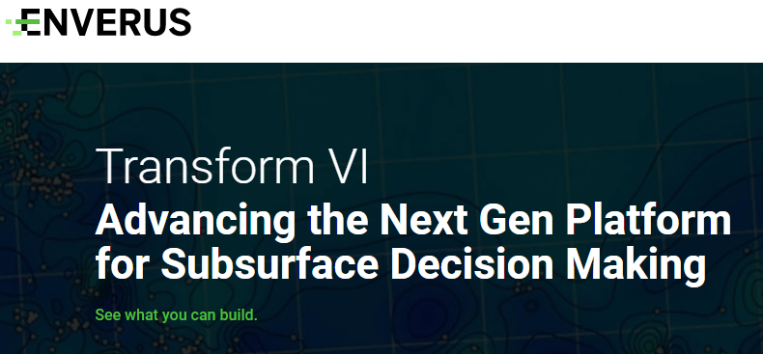
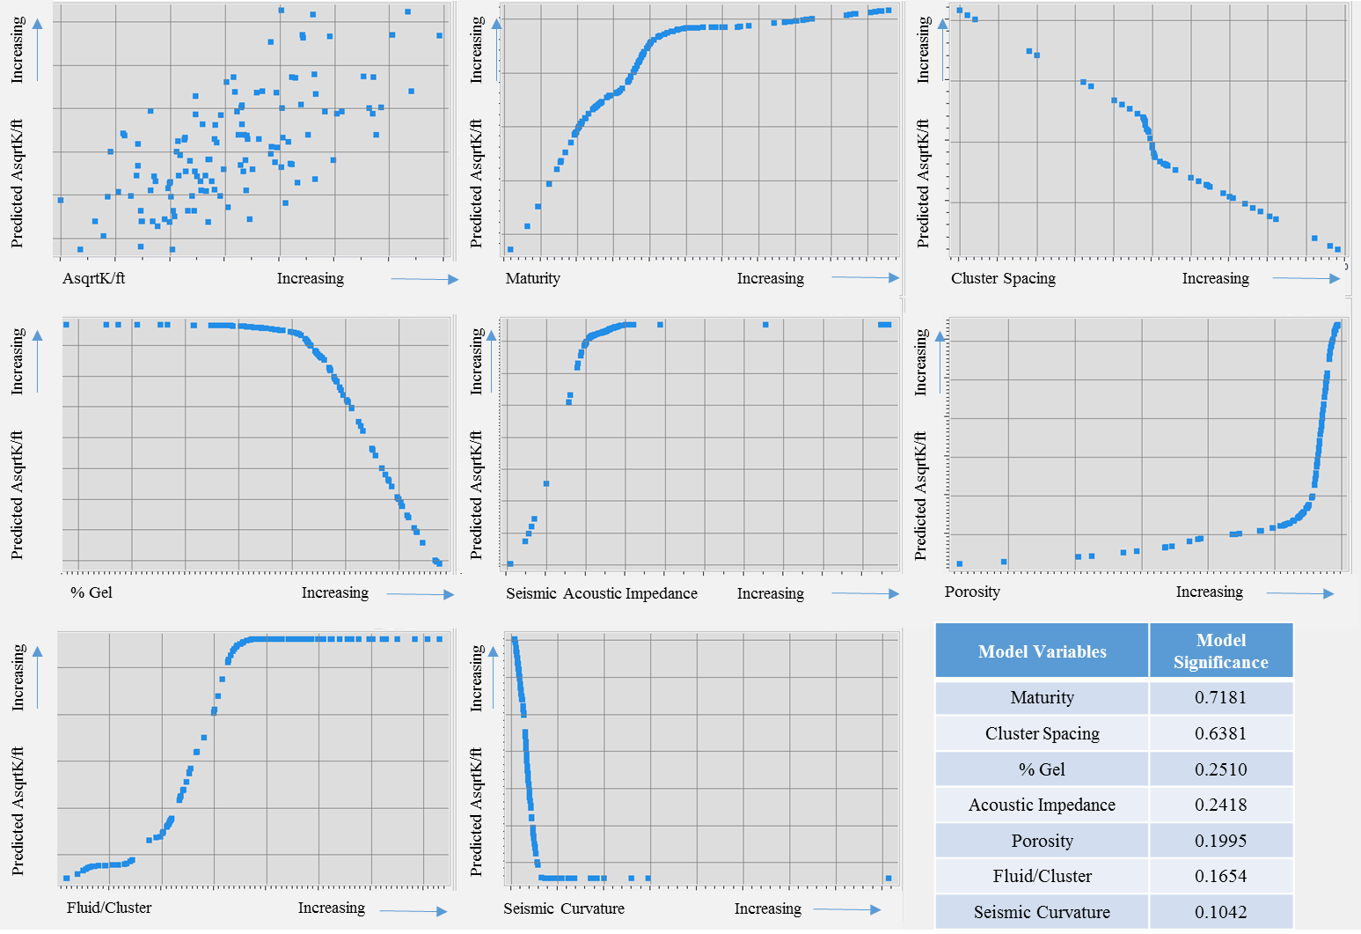
Multivariate Model
Ran the model with selected variables in Transform application (Enverus).
QC’d model relationships using ‘Transform’ plots to ensure each variable within the model makes sense.
Plots show predicted increase/model sensitivity on Y with increasing values of each variable X.

Slide 18
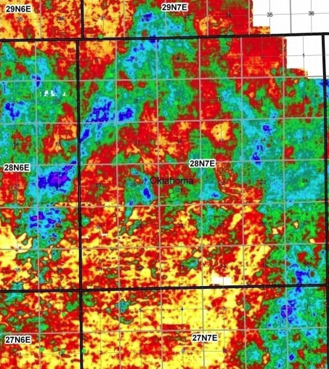
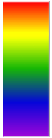
12 Month Oil Production Prediction Map
Created a map to predict 12 month oil production
Compared predictive values to actual values
QC’d model and worked to find variables that might not be represented in or accounted for in the model.
Iterated…
12 Month
Oil (MBO)

Slide 19
Results
Our work and mapping significantly increased the teams ability to predict oil production in the Miss Lime.
7 of the 8 wells that we selected had economics > 30% ROI.
Average daily oil production more than doubled from the previous year
By comparison, more than half of the 30 wells drilled the year before lost money.
Notes:
Action –Results - Our work and mapping significantly increased our ability to predict oil production in the Miss Lime. In fact, seven of the eight wells our team selected had economics that exceeded 30% ROR. By comparison, more than half of the 30 wells drilled the year before lost money.

Slide 20
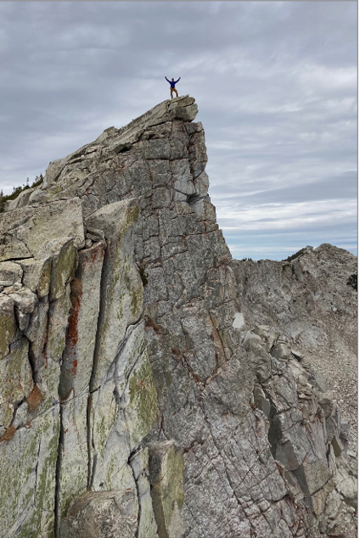
Questions?

Slide 21
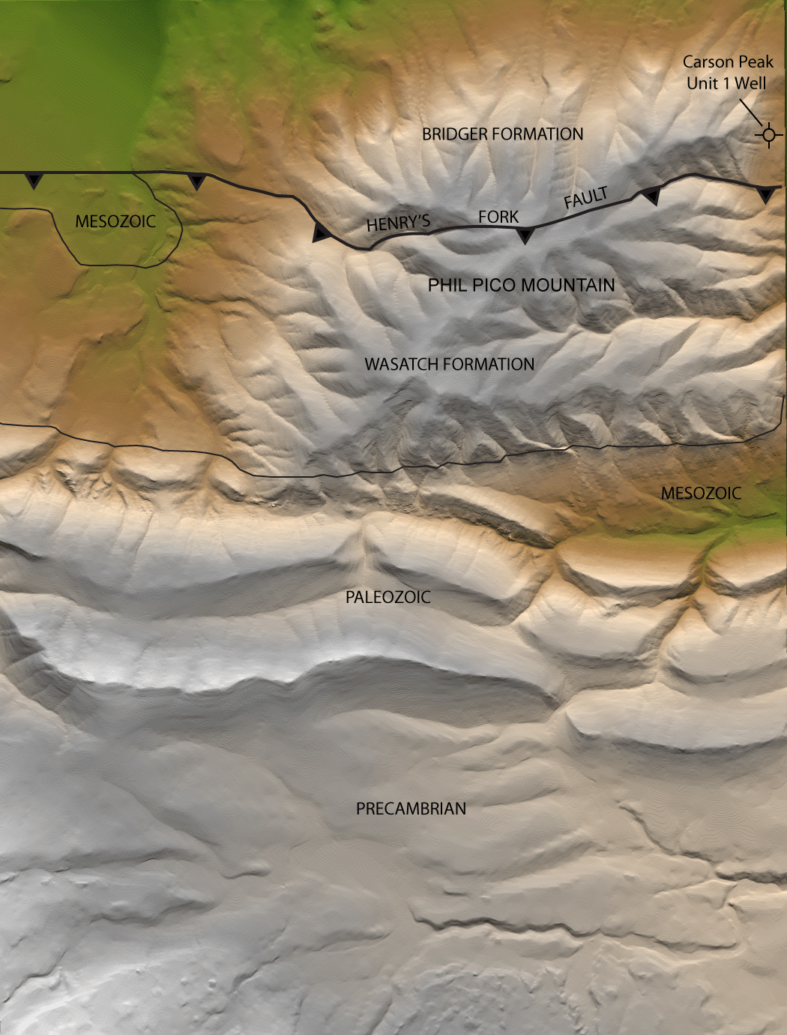
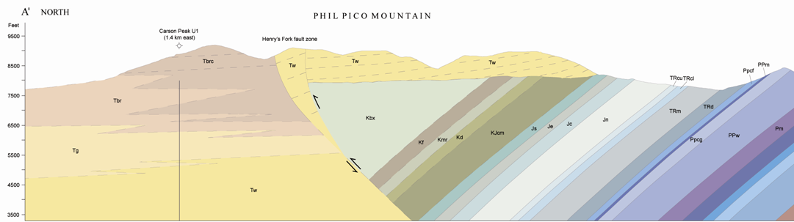
When were the Uinta Mountains Formed?
A
Conglomerates on the north flank of the Uinta Mountains preserve the erosional and uplift
Bridger Formation
Wasatch Formation
A’
A
A’

Slide 22
